Slide 1
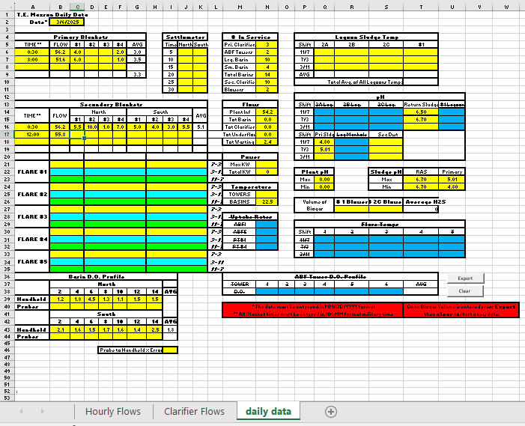
Calculated on “Clarifier Flows” page
Entered here on “daily data” page
Ignore ; defunct
Will read from Ovation, non-current
No cells on this page reference the Hourly Flow.
Blue highlight indicates non-current cells.
Flares not currently operational.

